Slide 1



SESSION NAME HERE
ORDER COMPLEXITY

Slide 2


Foundational Sessions Housekeeping
The use of disrespectful language is prohibited in the questions, this is a supportive, learning environment for all - please engage accordingly. (FBV: Mutual Respect.)
No question is daft or silly - ask them!
There are Q&A sessions midway and at the end of the session, should you wish to ask any follow-up questions. Moderators are going to be answering questions as the session progresses as well.
If you have any questions outside of this lecture, or that are not answered during this lecture, please do submit these for upcoming Open Classes. You can submit these questions here:
SE Open Class Questions or DS Open Class Questions

Slide 3
Foundational Sessions Housekeeping cont.
For all non-academic questions, please submit a query: www.hyperiondev.com/support
Report a safeguarding incident: www.hyperiondev.com/safeguardreporting
We would love your feedback on lectures: Feedback on Lectures

Slide 4


Reminders!
Guided Learning Hours By now, ideally you should have 7 GLHs per week accrued. Remember to attend any and all sessions for support, and to ensure you reach 112 GLHs by the close of your Skills Bootcamp.
CONFIDENTIAL

Slide 5
Progression Criteria
✅ Criterion 1: Initial Requirements
Complete 15 hours of Guided Learning Hours and the first four tasks within two weeks.
✅ Criterion 2: Mid-Course Progress
Software Engineering: Finish 14 tasks by week 8.
Data Science: Finish 13 tasks by week 8.
✅ Criterion 3: Post-Course Progress
Complete all mandatory tasks by 24th March 2024.
Record an Invitation to Interview within 4 weeks of course completion, or by 30th March 2024.
Achieve 112 GLH by 24th March 2024.
✅ Criterion 4: Employability
Record a Final Job Outcome within 12 weeks of graduation, or by 23rd September 2024.
CONFIDENTIAL

Slide 6

Order Complexity Topics
Data Structures and Algorithms
Algorithm Complexity Analysis
Common Algorithms and Complexity

Slide 7

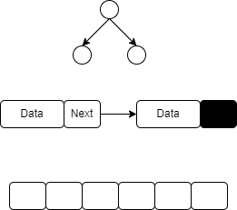
Data Structures and Algorithms
A data structure is a specialized format for organizing, processing, retrieving and storing data
Example: Trees, LinkedList, Arrays
An algorithm is a sequence of steps executed by a computer that takes an input and transforms it into a target output. It should terminate in a decent amount of time.
Example: Search and Sorting Algorithms

Slide 8
Why is Order Complexity Important?
Time complexity: measures the amount of time a function takes to complete.
Space complexity: measures the amount of memory space required by a function.
Algorithm Design and Optimization: Pinpoints inefficiencies for improved performance.
Comparative Analysis: Quantitatively compares algorithms for suitability.
Predictive Ability: Anticipates performance issues for large data sizes.

Slide 9
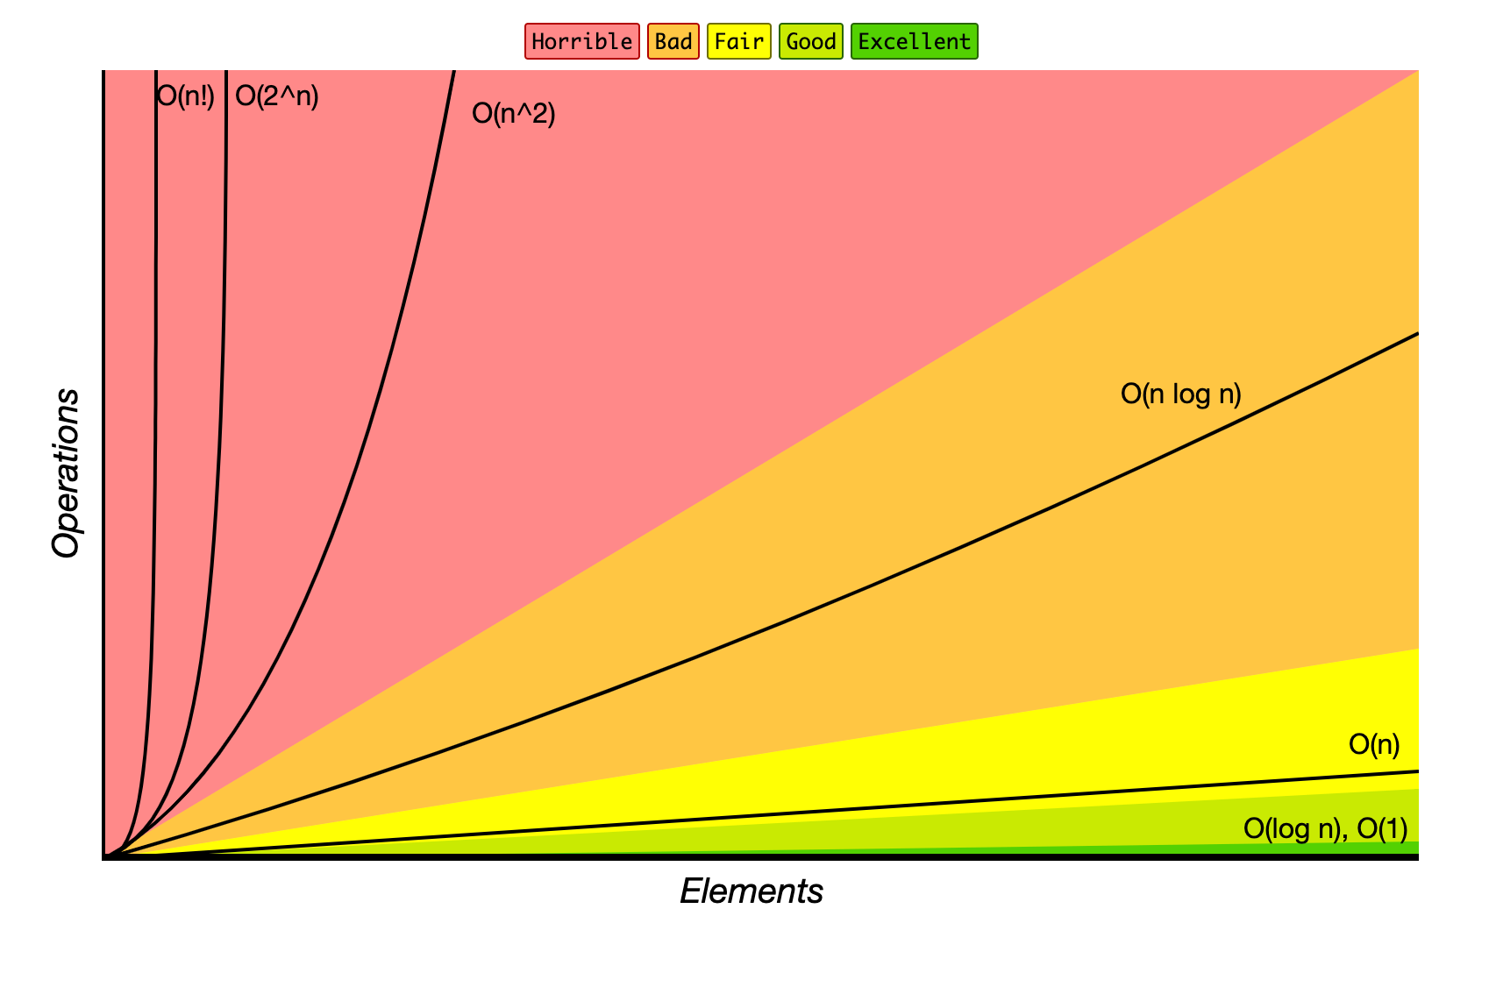
Common Complexities
Keep these complexities in mind throughout the lecture as they are important and the most used complexities in industry.

Slide 10
Common Sorting and Searching Algorithms
Common sorting algorithms:
Bubble Sort - Time Complexity: O(n²), Space Complexity: O(1)
Selection Sort - Time Complexity: O(n²), Space Complexity: O(1)
Insertion Sort - Time Complexity: O(n²), Space Complexity: O(1)
Merge Sort - Time Complexity: O(n log(n)), Space Complexity: O(n)
Quick Sort - Time Complexity: O(n log(n)) average, O(n²) worst-case, Space Complexity: O(log(n))

Slide 11
Common searching algorithms:
Linear Search - Time Complexity: O(n), Space Complexity: O(1)
Binary Search - Time Complexity: O(log(n)), Space Complexity: O(1)

Slide 12
Summary
Complexity Analysis
A measure of the amount of resources, such as time and/or space, required by an algorithm to solve a problem as a function of the size of the input.
Measured by Big O Notation, which measures the worst-case complexity and allows comparison of algorithms.

Slide 13


Thank you
for joining us
Take regular breaks
Stay hydrated
Avoid prolonged screen time
Practice good posture
Get regular exercise
“With great power comes great responsibility”

Slide 14


Questions and Answers
Questions around Order of Complexity

